Slide 1
Multiplicity
Brian Caffo, Jeff Leek, Roger Peng
@bcaffo
www.bcaffo.com

Slide 2


http://www.cliparthut.com/gone-fishing-clipart.html
https://www.pinterest.com/cirera/cartoons/

Slide 3
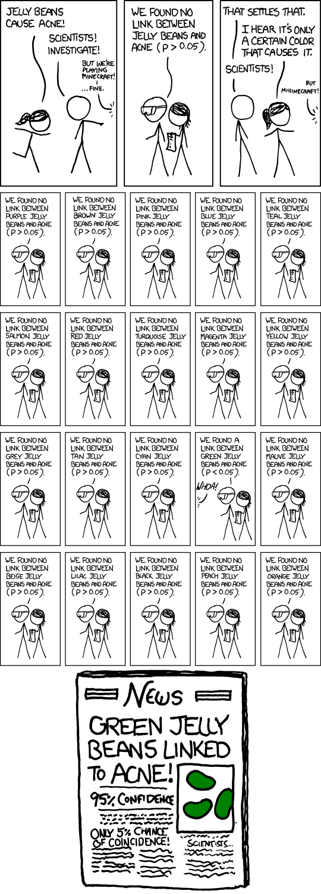
Homework: Read XKCD comic 882
https://xkcd.com/882/

Slide 4


Slide 5
Multiple comparisons can arise from applying many tests and focusing on the significant ones
Fitting too many models
Looking at too many quantities of interest
Fishing expeditions - testing everything without a priori hypotheses

Slide 6
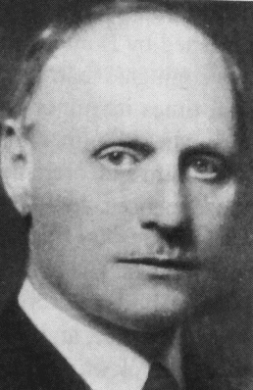
Easiest fix
Easiest fix - multiply your P-values by the number of tests performed
10 tests and a P-value of 0.01, now it’s 0.10
"Carlo Emilio Bonferroni" by Unknown - http://www.analyticquest.com/gallery Licensed under Public Domain via Commons - https://commons.wikimedia.org/wiki/File:Carlo_Emilio_Bonferroni.jpg#/media
/File:Carlo_Emilio_Bonferroni.jpg

Slide 7
Summary notes
There’s a vast literature on multiple comparison procedures and rules
The Bonferroni correction is simple and robust, though can be quite conservative

